Slide 1
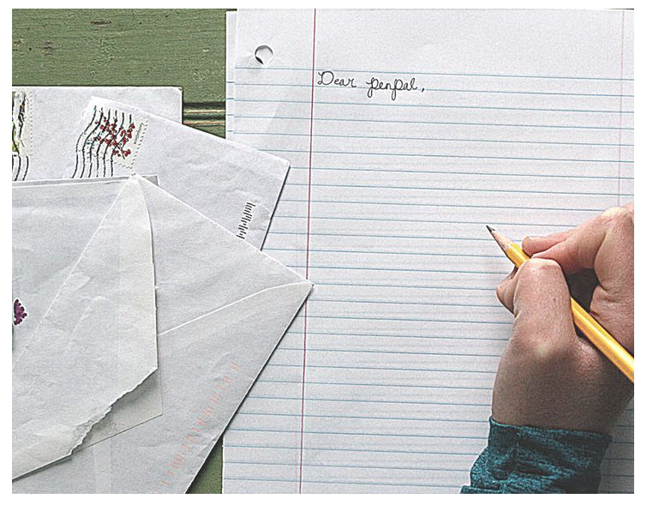
How to Write a Friendly Letter

Slide 2
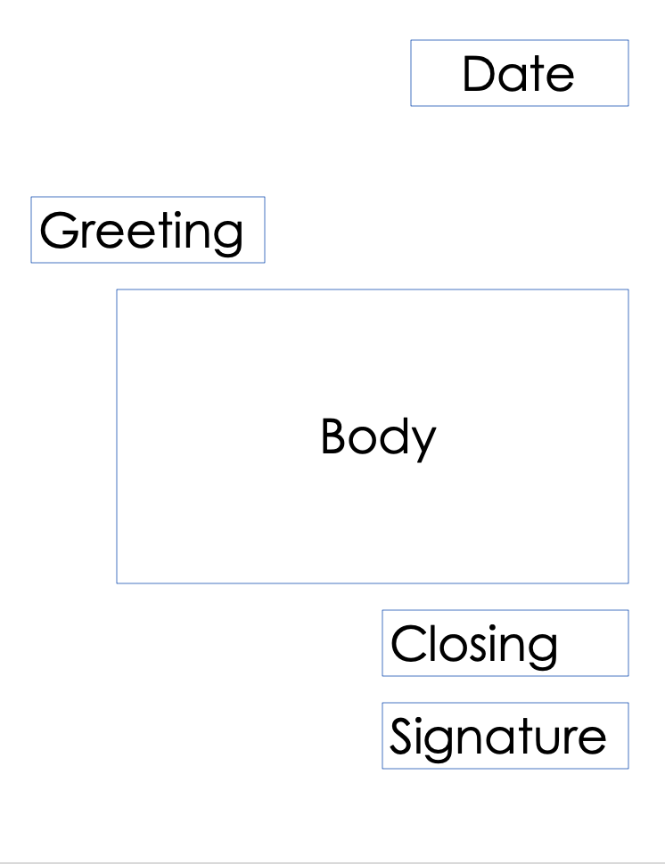
Let’s learn how to write a letter
A letter has 5 parts!
-Heading
-Greeting
-Body
-Closing
-Signature

Slide 3
Write with me!
This is just practice!
Start in the top right hand corner.
Write the date: Monday, date, year

Slide 4
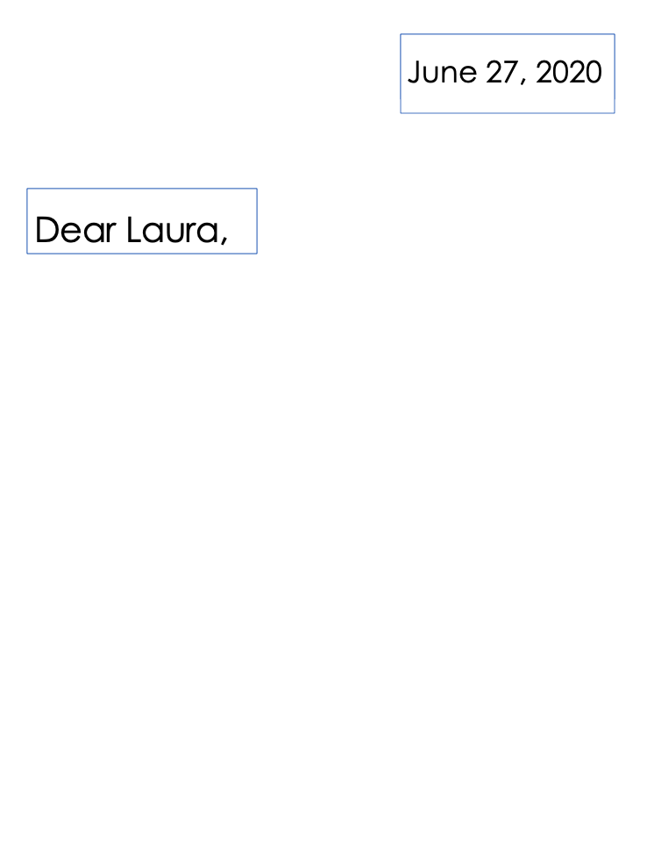
Next, add your greeting.
Greeting is saying hello to the person to whom you are writing.
Usually use “dear” but you can use other phrases too!

Slide 5
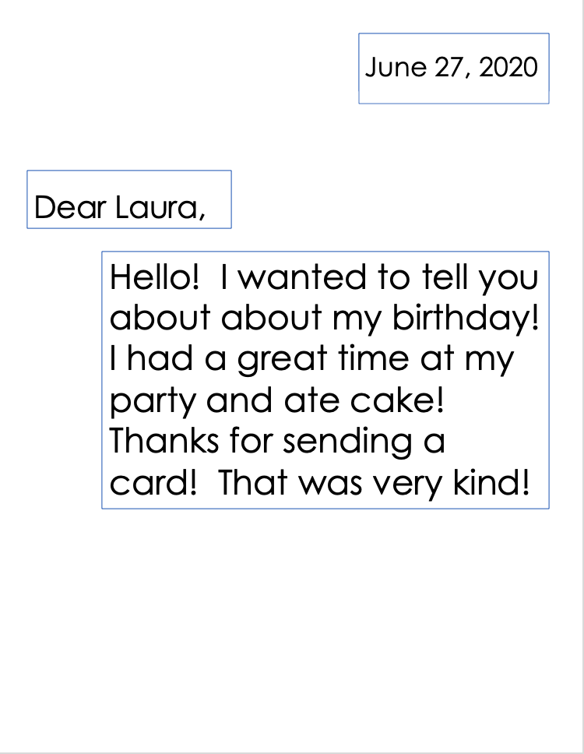
Now, the body of the letter!
The body is the content of the letter. This is where you tell stories or information, or ask questions.
The longest part.

Slide 6
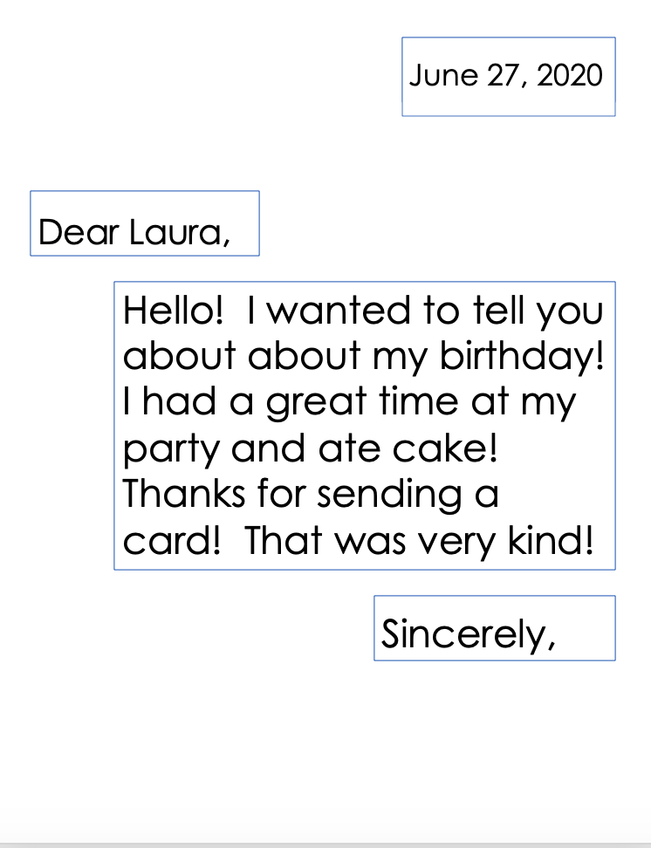
Then, we close the letter.
Write on the right side, not left to show a different section.
The closing is short.
Describes your feeling as you send it.
Oftentimes we use “sincerely,” “with love,” or “your friend.”

Slide 7
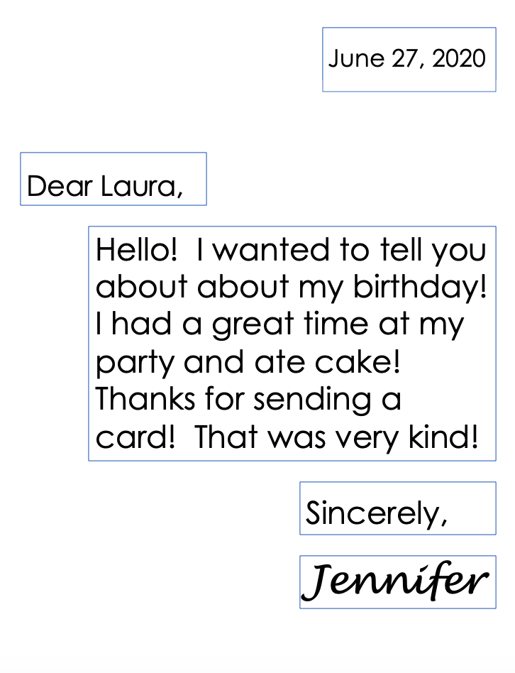
Finally, sign your name!
Tell who is writing the letter!
You can use your signature, or just print your name.

Slide 8
You’re done! It is ready to send!

Slide 9
What materials do I need for my letter?
Paper, stationery, notecard?
Pens, pencil, type?

Slide 10
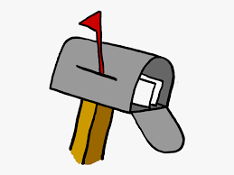
Who will you write to?

Slide 11
Oh no! What will I write about?
Describe your life
Family
Hobbies
Pets
School
Ask questions!

Slide 12
Let’s start writing!

Slide 13
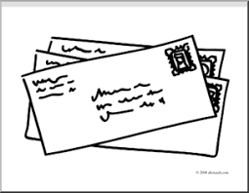
You will need an envelope, stamp, and the address of your recipient!

Slide 14
Get excited for mail in your mailbox! (Be patient!)

