Slide 1
Punctuation on the ACT
Quick Tips on how to figure out which punctuation to use!

Slide 2
Semicolons ;
Students often don’t see the value of homework, they complete their assignment out of necessity rather than out of a desire to learn.
This is the most often tested punctuation of the three.
The rule with the semicolon usage is simple: there must be an INDEPENDENT clause on either side of the semicolon.
Remember an INDEPENDENT clause can stand alone as a complete sentence and contains a subject and predicate (verb).
Students often don’t see the value of homework; they complete their assignment out of necessity rather than out of a desire to learn.
Students often don’t see the value of homework, because they complete their assignments out of necessity rather than out of a desire to learn.
Students often don’t see the value of homework. They complete their assignments out of necessity rather than out of a desire to learn.

Slide 3
Colons :
There are three ways in which colons are used most often.
1. To introduce something that follows logically; that is, an effect or consequences
2.To introduce the elements in a list
3. To introduce a quote
There was one thing stopping me from getting up n that stage: pure, unadulterated fear.
I have three items in my grocery bag: apples, oranges, and carrots.
George W. Bush unwittingly summarized his entire presidential career with one unforgettable phrase: “They misunderestimated me.”
Notice that with all of the examples: the clause which preceded the colon must be INDEPENDENT.

Slide 4
Dash -
The dash is NOT a hyphen.
A hyphen connects certain compound words – the dash has no such function.
The dash is used to:
1. To interrupt a sentence with an important, attention-grabbing phrase
2.To set off interrupting elements within a sentence (serves the same function as comma, but provides emphasis).
3. To introduce an explanation in the same way a colon would.
Time spent in prison can change your outlook- especially if you have a life sentence.
It was apparent to me – after hours of deliberation – that I had made a wrong decision.
Jack was gentle, but persistent, with his new black lab puppy – he would train him to be a fine hunting dog one day.

Slide 5
Dash -
In the following sentence the dash is used correctly since the phrases within the dashes interrupts the sense of the sentence.
When I first met my husband – his face was smeared with jelly – I was only five years old.
In the following sentence the dash is incorrect because the interrupting phrase gives additional information and is now a break or shift in thought.
Mr. Graham – Stephan’s baseball coach – will drive the team home after practice.
The correct sentence should say:
Mr. Graham, Stephan’s baseball coach, will drive the team home after practice.

Slide 6
Comma ,
This is the single most important rule to keep in mind when dealing with commas on the ACT: if you aren't sure if you need a comma, you probably don't need a comma.
In fact, you're far more likely to miss a question because you add in an unnecessary comma than you are to miss one because you left an important comma out.

Slide 7
Comma ,
The four rules you absolutely have to know deal with modifying phrases and clauses, introductory phrases and clauses, connecting independent clauses with a conjunction, and separating items in a list.

Slide 8
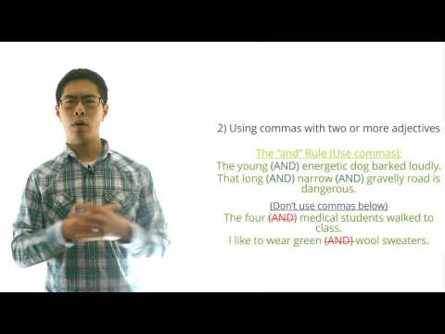
Comma ,

